Slide 1
Destination Dynamics:
Solution for sustainable Tourism
Team 7:
Karan Talati
Sai Swetha Vadrevu
Nithin Reddy Tummala

Slide 2
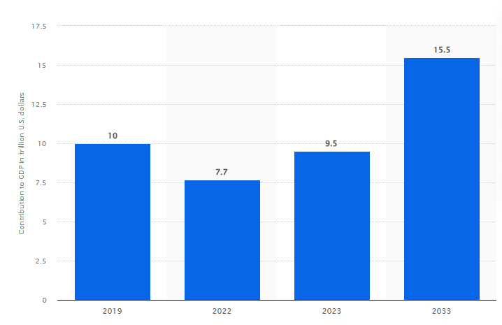
Problem Statement
Tourism in many countries is often concentrated in a few well-known locations, leading to overcrowding, environmental degradation, and ruins the visitor experiences.
Travel industry has seen a huge surge from 22% to 87% after global pandemic.
The uneven distribution of tourism not only impacts popular destinations but also overlooks the economic development of less visited regions.
So by balancing travellers or just redistributing them will help maintaining the traveler’s experience and at the same time helping local authorities preserve the dignity of the destination

Slide 3
Literature review
Roman Egger believe in gathering real time feedback from the internet to identify signs of overtourism, such as complaints about crowding or environmental degradation.
Researchers have described the importance of using web scraping to collect and analyze the online data from websites like Tripadvisor and Booking.com.
A certain set of researchers in Austria are working on building a visitor flow management where tourism managers monitor visitor volumes in real time and develop solutions for managing visitor flows more effectively, showcasing the potential of data for mobility and capacity management in tourism regions.
Analytics based forecasting tools have shown great value when integrated into travel booking platforms, particularly for flight reservations. These tools also hold potential for broader applications across various sectors of the travel and hospitality industry.

Slide 4
Data Collection
Initial web searches yielded limited relevant data, focusing primarily on traveler demographics such as country of origin, spending habits, length of stay, and accommodation preferences, none of which directly correlated with the visitor number data needed for our project.
After reaching out to few b2b companies providing tech solution to this sector, we came across ForwardKeys who shared their valuable data of visitors from Jan 2022 to Jan 2024.
Dataset includes the visitors counts from 1st jan 2022 to 31st Jan 2024 for location such as Blue Lagoon, Doge’s palace, Taj Mahal, Louvre Museum and Machu Picchu for time slots of the day. Along with that they also provided the average age of the visitors and geotags used during that specific time frame.

Slide 5
Research Questions
How effectively can time series analysis, utilizing visitor count, dates, time slots, and seasonality variables from the dataset, predict crowd levels at high-traffic tourist attractions, and in what ways can these predictions be leveraged to enhance tourist experiences and preserve destination integrity?
How can the analysis of age demographics and their visiting patterns assist in predicting the number of visitors during specific time slots at popular tourist attractions, and how can this demographic insight be utilized to tailor tourist experiences more effectively?
What impact does the implementation of a dynamic pricing model have on the economic sustainability of tourist destinations, and how significantly can it alter visitor behavior in terms of choosing less crowded times and destinations?
What external factors like weather influence visitor numbers, and how can these be integrated into the predictive model?

Slide 6
Model Assessment
Predicting the visitors count:
Models assessed: ARIMA, XGBoost, Stacking (Decision Tree, KNN and SVR), CNN, LSTM and GRU
Features: Date, time, day and day of the week
Target: Visitors count at a specific time slot.
Predicting the average age of visitors:
Models assessed: Random Forest regressor, Stacking (random forest and gradient boost)
Features: Date, time, day and day of the week
Target: Average age of visitors in each location

Slide 7
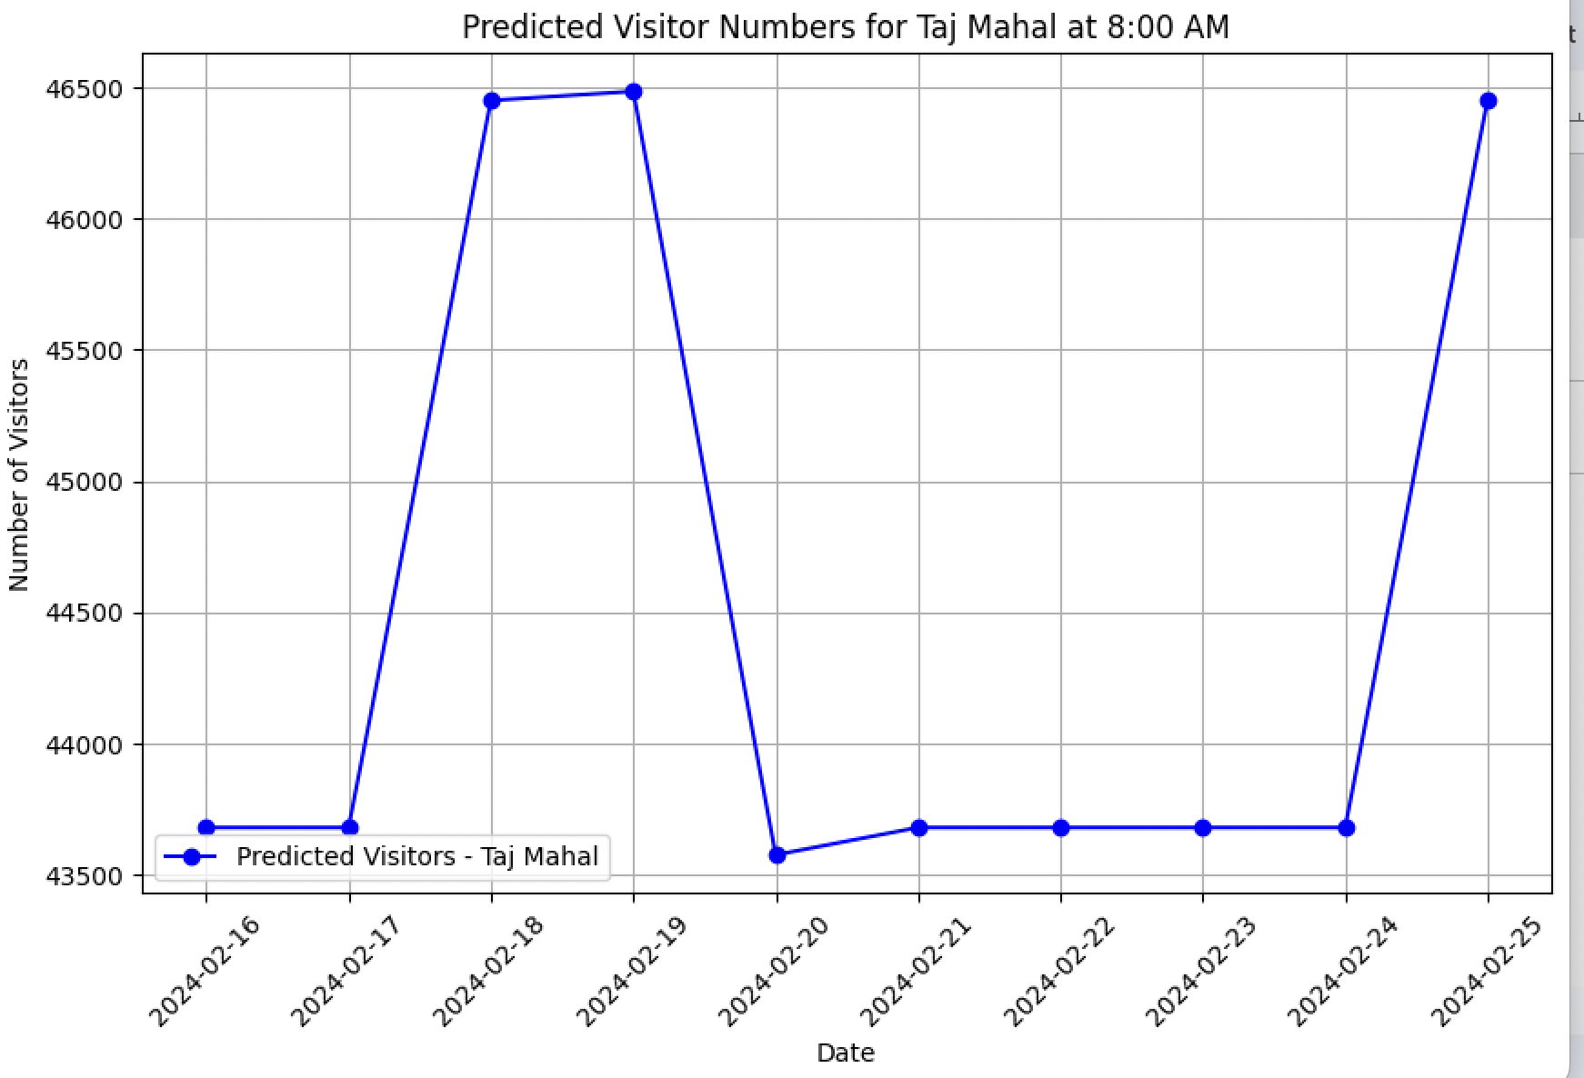
Let’s consider Taj Mahal as the base location to predict visitors count in 8 AM time slot
XGBoost
XG Boost
 | RMSE | R Squared
Train data | 12105.91 | 0.187
Test data | 13233.15 | 0.137

Slide 8
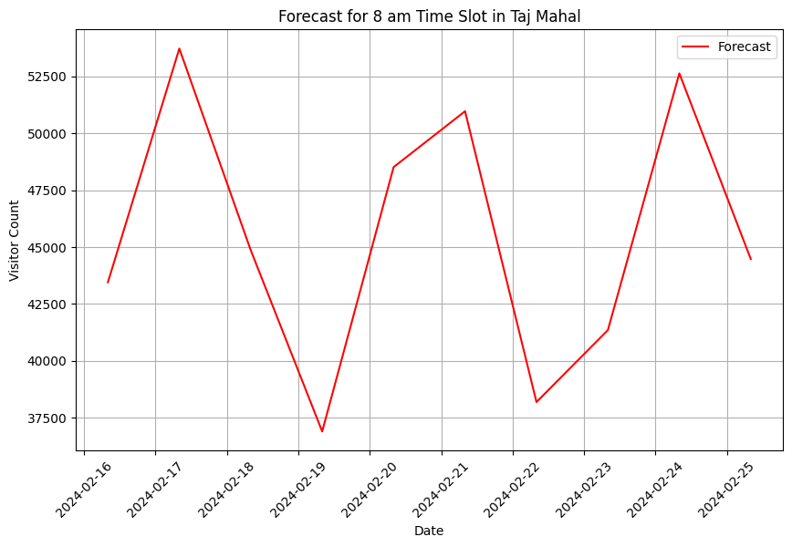
ARIMA
 | RMSE | R Squared
Train data | 10598.25 | 0.399
Test data | 11536.79 | 0.253

Slide 9
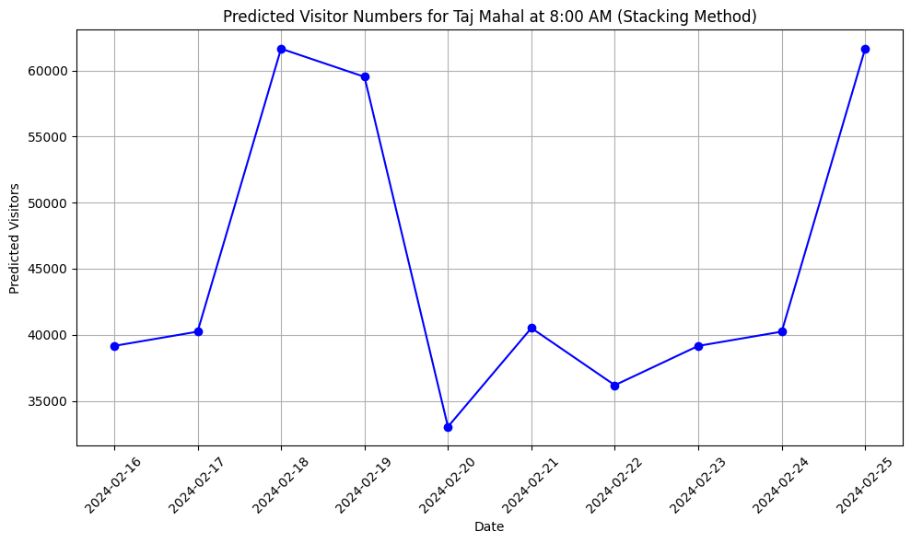
Stacking (Decision Tree, KNN and SVR)
 | RMSE | R Squared
Train data | 1941.18 | 0.80
Test data | 5973.89 | 0.82

Slide 10
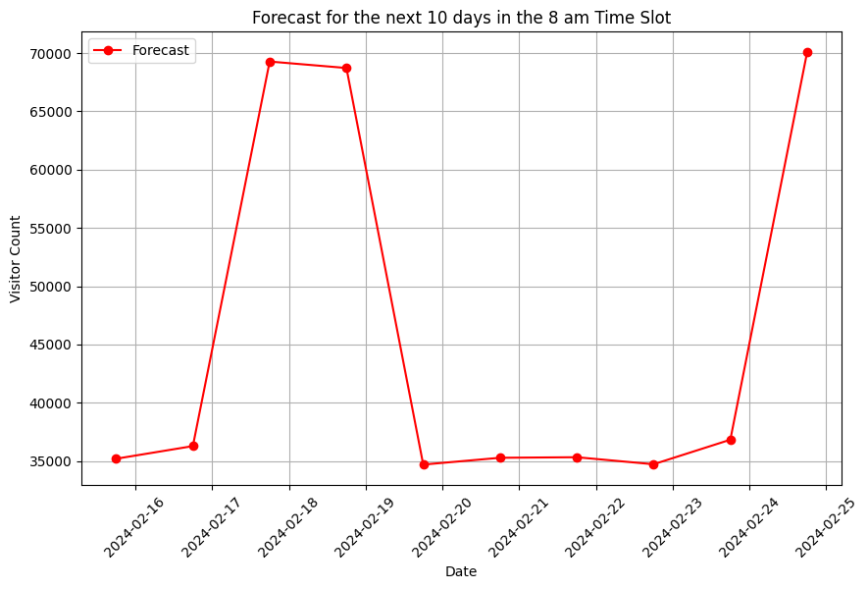
CNN
Input Layer: Conv1D
Maxpooling Layer: MaxPooling1D (pool_size=2)
Flatten Layer
Dense Layers: 2
Activation Function: Relu
Calculated loss for batch size= 32, epoch= 100 with Adam Optimizer
 | RMSE | R Squared
Train data | 4822.76 | 0.87
Test data | 5130.74 | 0.85

Slide 11
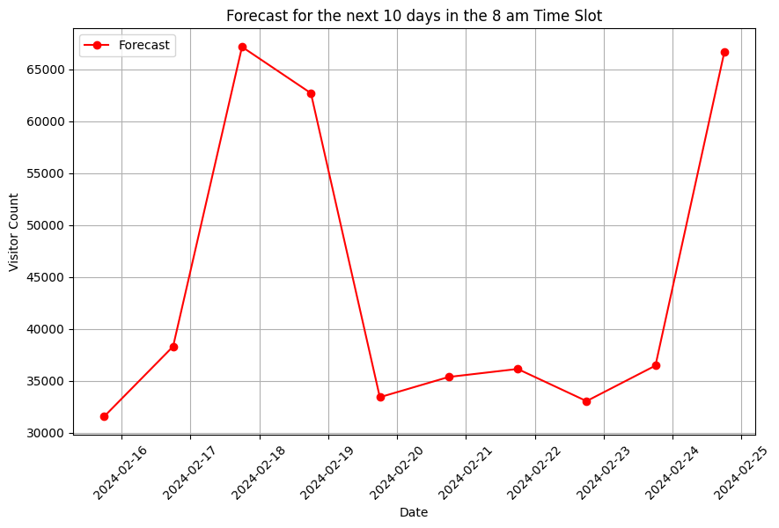
GRU
2 Layers
Relu activation function
32 neurons in each layer
Epoch: 200
Adam’s Optimizer
 | RMSE | R Squared
Train data | 4488.08 | 0.889
Test data | 4553.20 | 0.892

Slide 12
LSTM
3 Layers, 1 fully connected layer
64 neurons in each layer
Epoch: 170
Adam’s Optimizer
 | RMSE | R squared
Train data | 4463.25 | 0.890
Test data | 4396.71 | 0.913

Slide 13
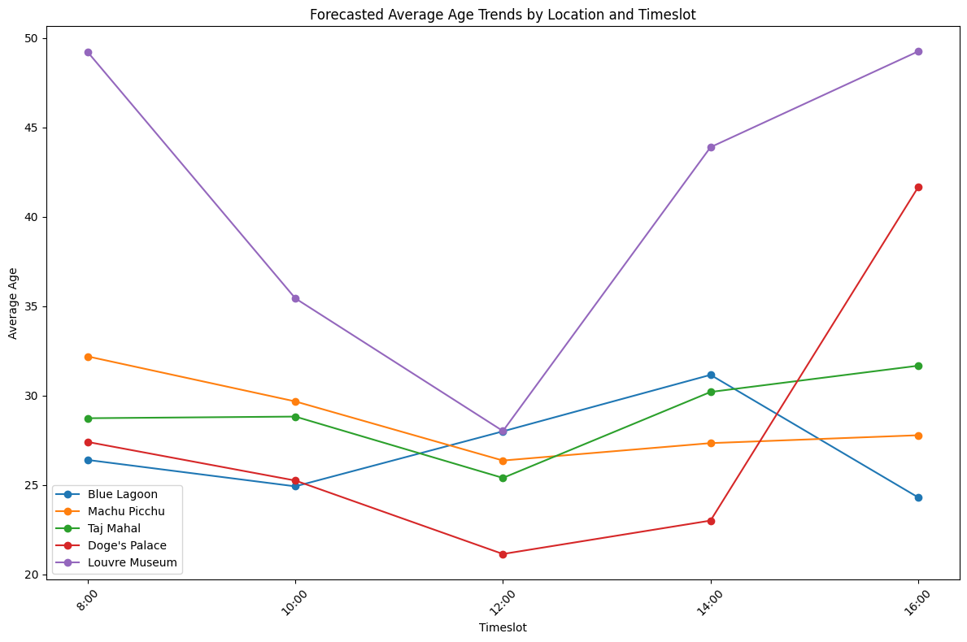
Predicting the average age in each time slot:
Random Forest Regressor:
RMSE: 9.67
R Squared value: -0.18

Slide 14
Predicting the average age in each time slot:
Random Forest Regressor:
Location | 8:00 | 10:00 | 12:00 | 14:00 | 16:00
Blue Lagoon | 32.44 | 32.37 | 29.13 | 26.83 | 28.97
Machu Picchu | 32.47 | 30.29 | 23.65 | 28.25 | 24.75
Taj Mahal | 27.12 | 27.64 | 28.61 | 27.91 | 29.54
Doge's Palace | 40.70 | 25.61 | 28.47 | 26.43 | 37.63
Louvre Museum | 36.56 | 46.34 | 34.57 | 35.73 | 49.78

Slide 15
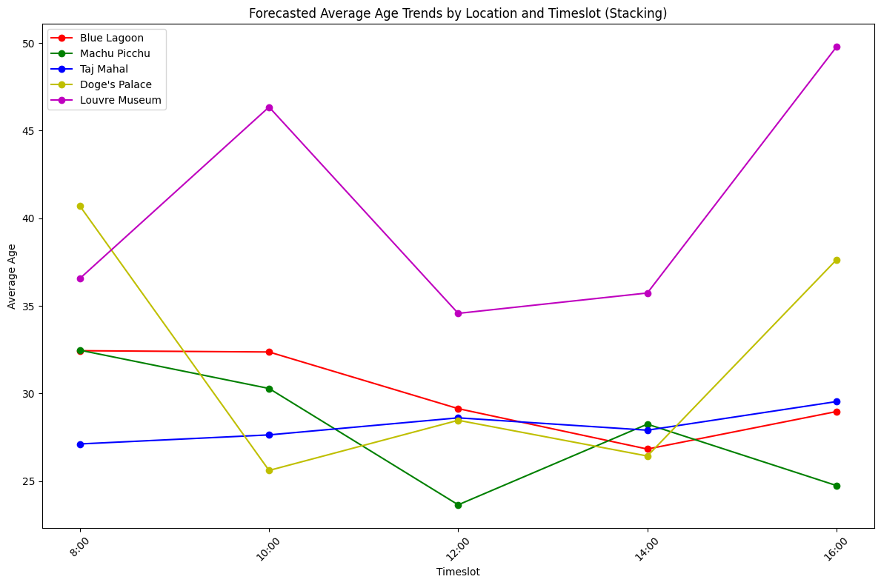
Stacking (Random Forest Regressor and Gradient Boosting regressor)
RMSE: 5.85
R Squared value: 0.57

Slide 16
Stacking (Random Forest Regressor and Gradient Boosting regressor)
Location | 8:00 | 10:00 | 12:00 | 14:00 | 16:00
Blue Lagoon | 26.39 | 24.91 | 27.99 | 31.15 | 24.30
Machu Picchu | 32.18 | 29.66 | 26.36 | 27.33 | 27.77
Taj Mahal | 28.72 | 28.82 | 25.38 | 30.19 | 31.66
Doge's Palace | 27.40 | 25.24 | 21.13 | 23.00 | 41.65
Louvre Museum | 49.21 | 35.43 | 28.01 | 43.89 | 49.24

Slide 17
Choosing Final Model
Tested LSTM models with 1, 2, 3, and 4 layers.
3-layer LSTM model achieved the best performance.
Performance comparison based on R squared values:
1 Layer LSTM: R squared = 0.87
2 Layers LSTM: R squared = 0.908
3 Layers LSTM: R squared = 0.913 (Optimal Model)
4 Layers LSTM: R squared = 0.76
The model with fewer or more than 3 layers showed decreased accuracy.
Opted for the 3-layer LSTM for optimal complexity and highest predictive accuracy.
After evaluating various models, we concluded that the 3-layer LSTM excels in forecasting visitor counts at each location.

Slide 18
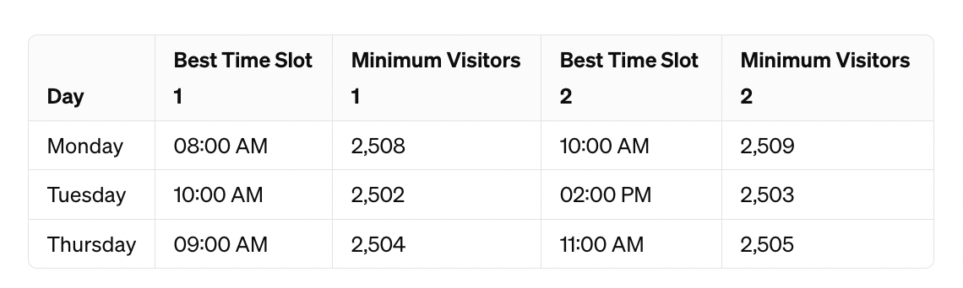
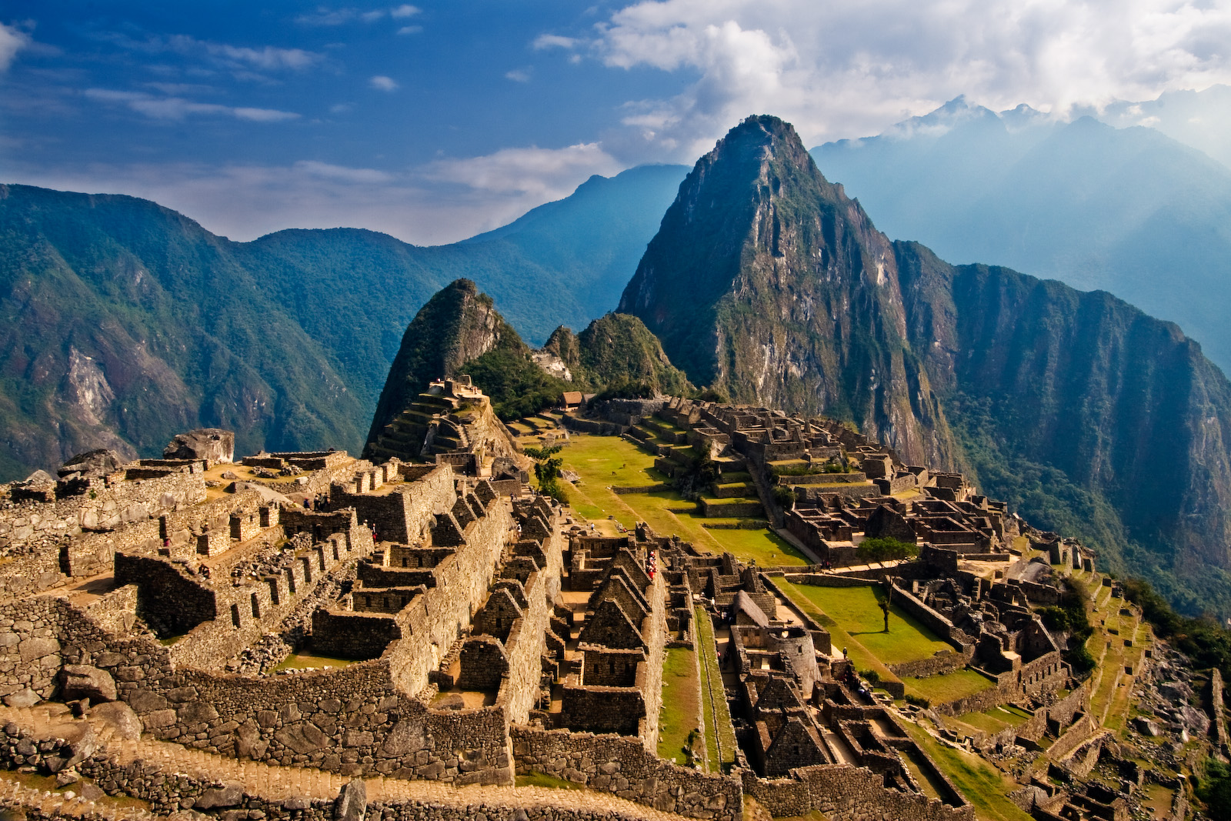
Findings of analysis (Machu Picchu)
Optimal Visit Times:
Early mornings on Monday & Thursday or late mornings on Tuesday offer quieter experiences at Machu Picchu.
Exploration Opportunities:
Visitors can enjoy calm walks, discover hidden spots, and take stunning photos during these times.
Enhanced Experience:
Smaller tour groups, personal interactions with guides, and peaceful surroundings contribute to a more memorable visit.

Slide 19
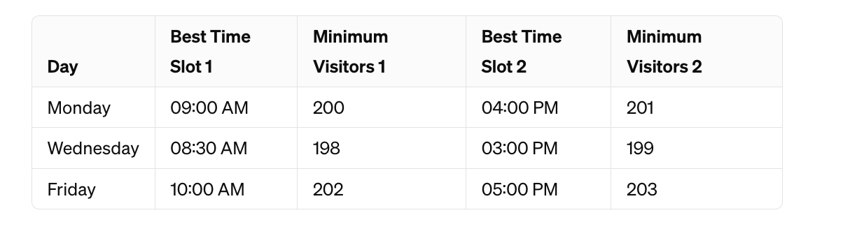
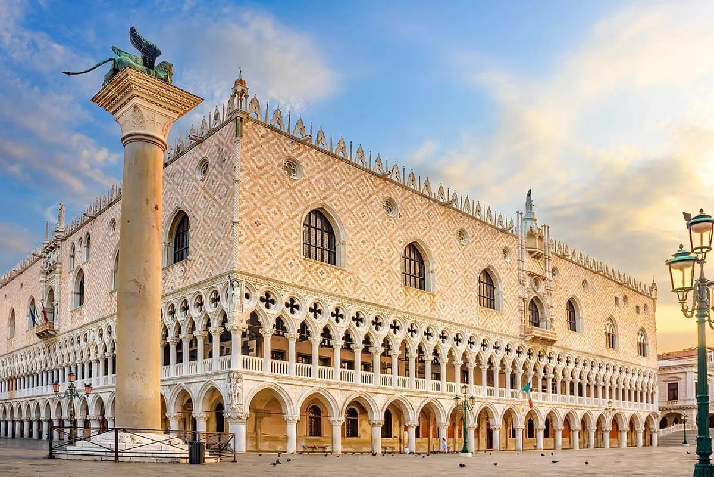
Doge's Palace
Morning Tranquility:
Enjoy peaceful mornings at the Doge's Palace, free from crowds.
Golden Hour Charm:
Experience the palace's beauty in the late afternoon sunlight for stunning photos.
Exclusive Access:
Explore exhibits and architecture intimately during quieter times.

Slide 20
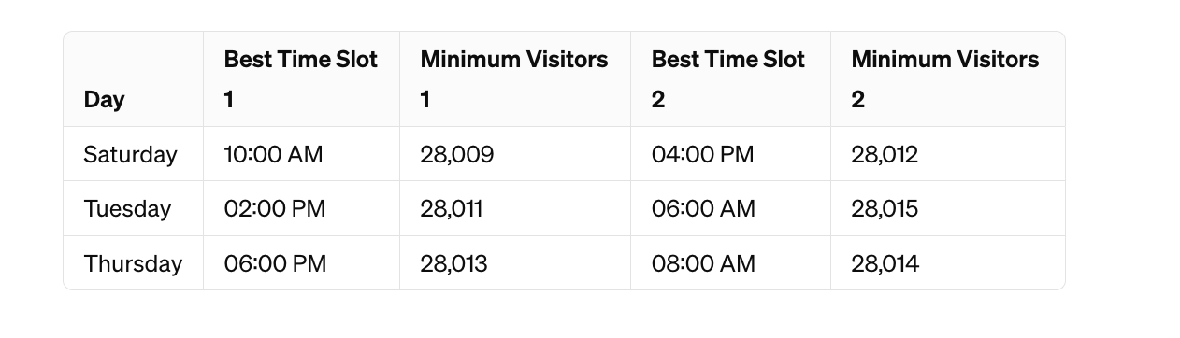
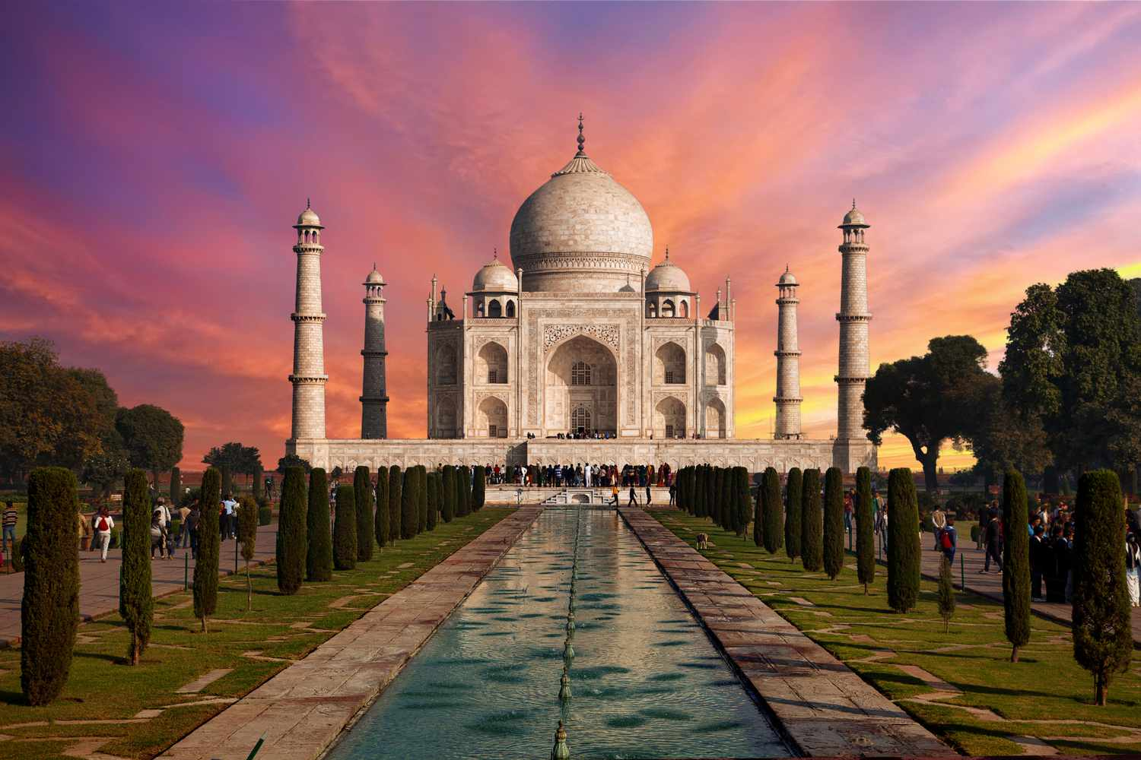
Taj Mahal
Saturdays at 10:00 AM offer tranquility with the fewest visitors at 28,009.
Tuesdays at 02:00 PM provide a serene afternoon experience with only 28,011 visitors.
Thursdays at 06:00 PM offer a peaceful sunset ambiance, with minimal crowds at 28,013.

Slide 21
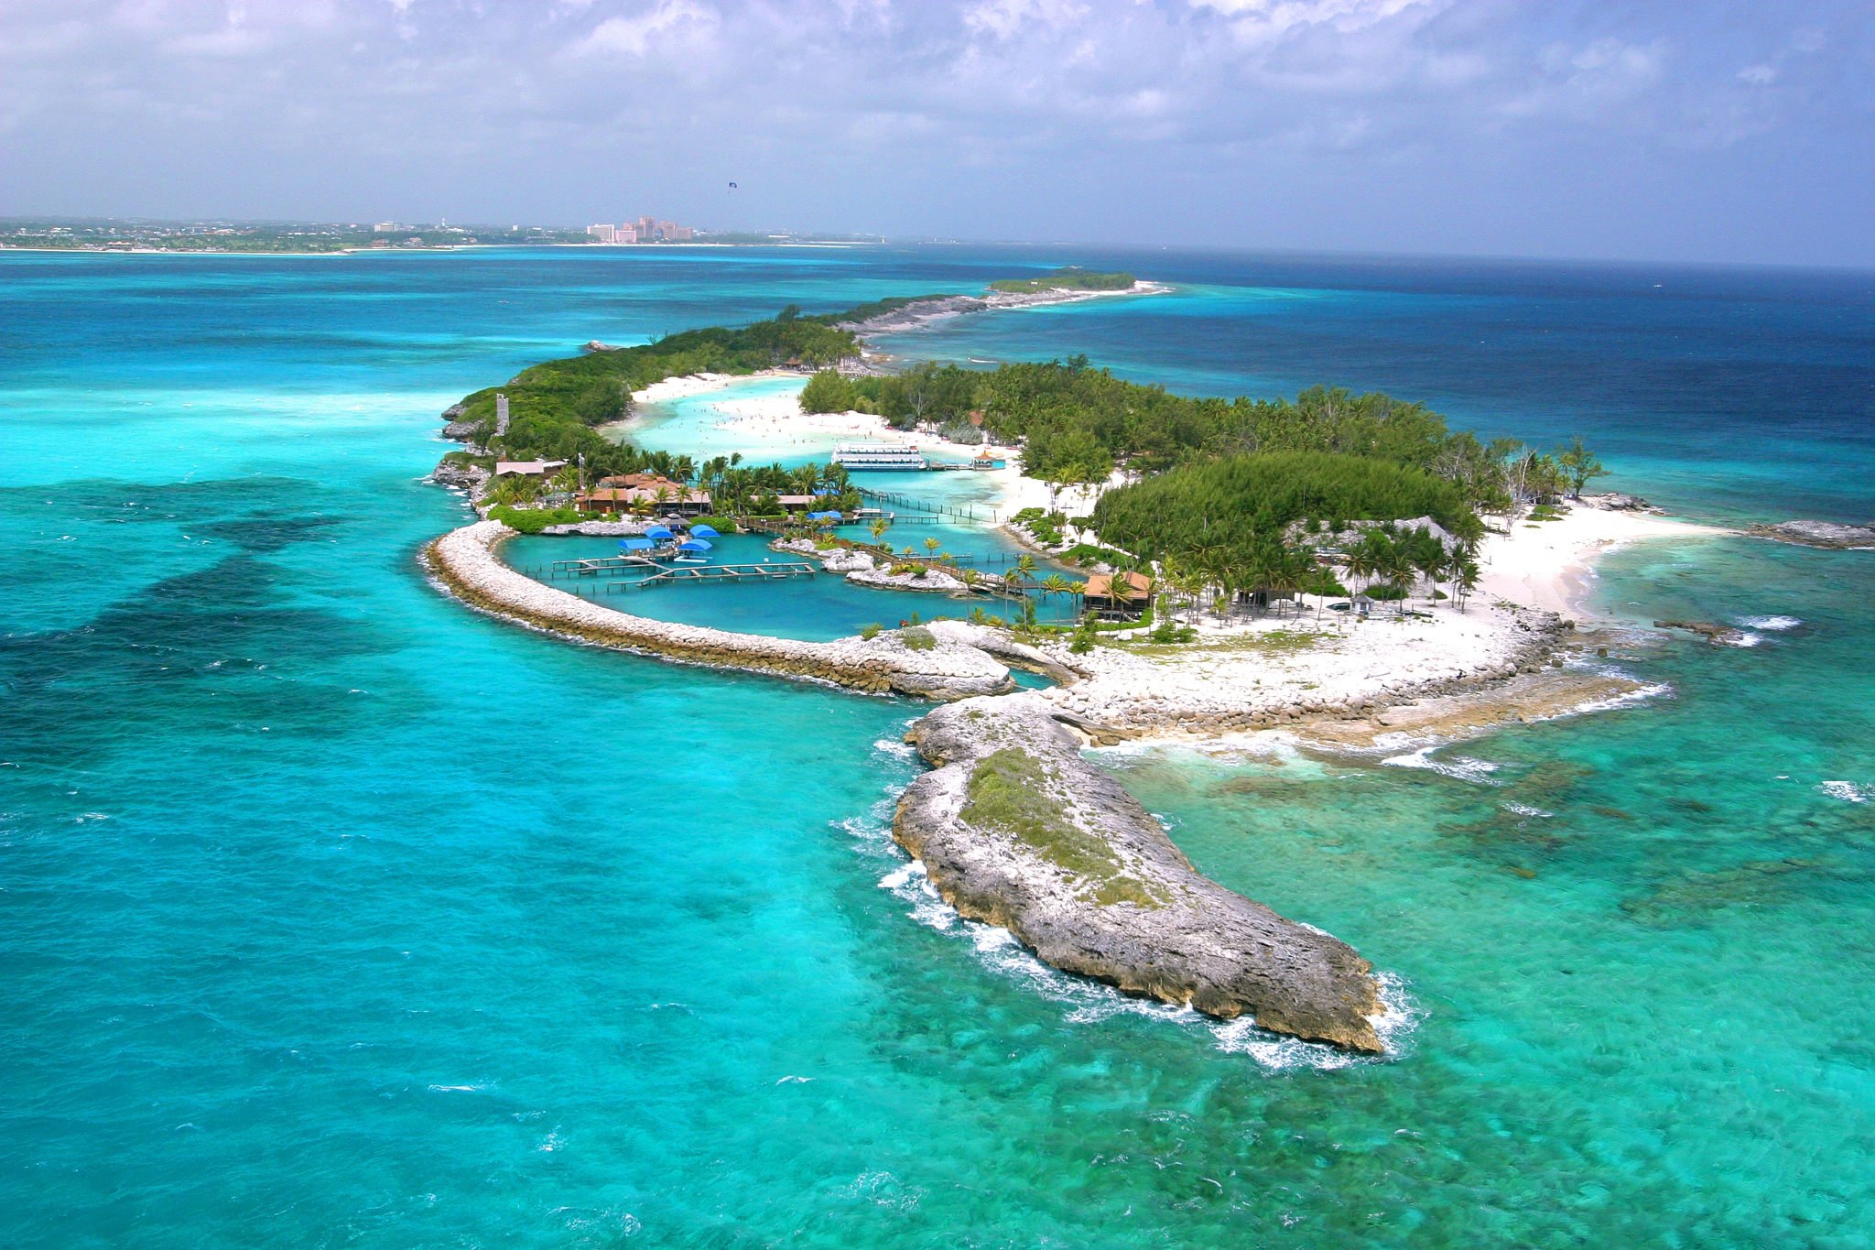
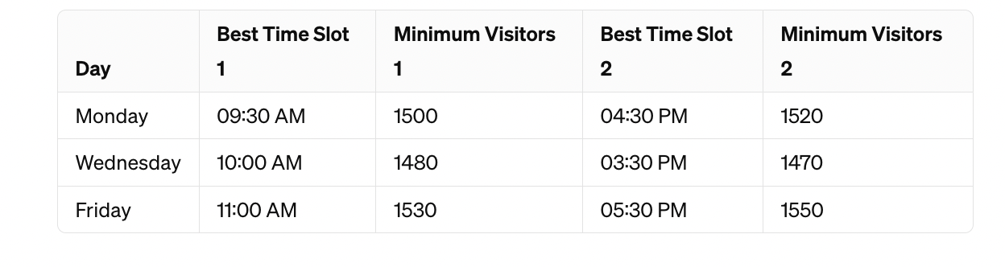
Blue Lagoon
Tranquil mornings: Enjoy the serene ambiance of the Blue Lagoon in the soft morning light, with fewer visitors providing ample space for relaxation.
Magical evenings: Witness the breathtaking beauty of the lagoon as the sun sets, casting a warm glow over the landscape and creating a peaceful atmosphere.
Healing retreat: Immerse yourself in the therapeutic waters of the Blue Lagoon, feeling the stress and tension melt away amidst the natural splendor.

Slide 22
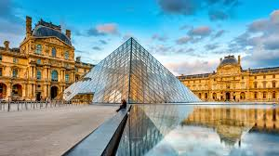
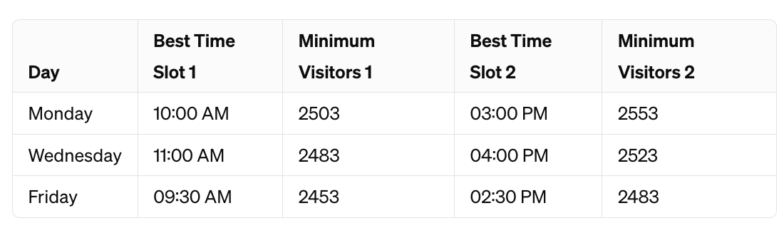
Louvre Museum
Solitary Serenity: Embark on a serene journey through the Louvre Museum during secluded Monday, Wednesday, and Friday mornings, where the absence of crowds fosters a tranquil environment for uninterrupted exploration.
Intimate Encounters: Engage intimately with world-famous artworks and unearth hidden gems amidst the museum's galleries, immersing yourself in a private dialogue with art and history.
Meaningful Reflection: Seize the opportunity to reflect deeply on each masterpiece, allowing the quietude of the morning hours to amplify the significance and resonance of your museum experience.

Slide 23
Dynamic Pricing Model
Base Prices:
Blue Lagoon: 50
Machu Picchu: 70
Taj Mahal: 40
Doge's Palace: 55
Louvre Museum: 65
Created a dynamic pricing model by adjusting the prices by 10% hike when crowded and 5% decrease when its not crowded.

Slide 24
Blue Lagoon:
Machu Picchu:
Taj Mahal:
Doge’s Palace:
Louvre Museum:

Slide 25
Thank You

